Slide 1


Slide 2
Background
Diabetes is a chronic disease that affects how your body utilizes insulin to transport circulating blood glucose into cells for energy consumption¹
Three main types of diabetes¹
More than 133 million people in the United States have diabetes or prediabetes¹
Medical costs and lost work and wages related to diabetes total $327 billion yearly¹
¹CDC Diabetes Information Page
Notes:
Type 1
Type 2
Gestational Diabetes (diabetes while pregnant)
37 million US adults have diabetes1
1 in 5 of people in the United States do not know they have diabetes
96 million US adults—over a third—have prediabetes1
8 in 10 of people in the United States do not know they have prediabetes
People with diabetes medical costs are twice as high as for people who don’t have diabetes

Slide 3
DATASET
Behavioral Risk Factor Surveillance System (BRFSS)
US-based annual telephone survey
Kaggle
Link: Diabetes Health Indicators Dataset
Notes:
BRFSS is a health-related telephone survey performed annually in the United States, District of Columbia, and three U.S. territories
Over 400,000 participants surveyed on health-related risk behaviors, chronic health conditions, and the use of preventative services
The original dataset contained responses from 441,455 individuals and had 330 features
Cleaned dataset limited to 22 columns, 253680 rows

Slide 4
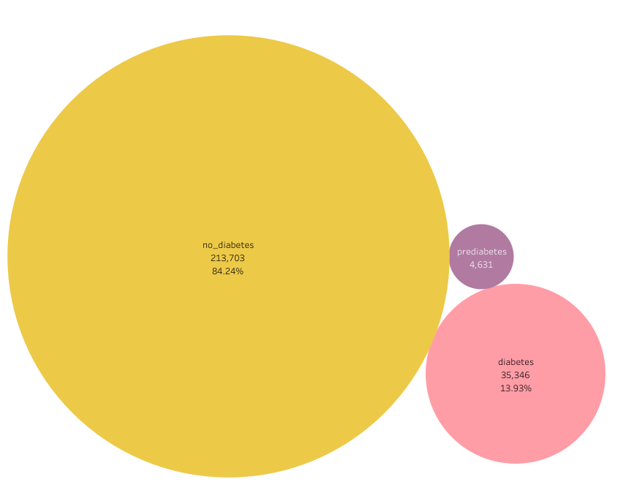
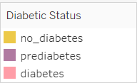
METHODS AnD results
PySpark was utilized to read in raw data and utilize SQL queries for EDA
Descriptive statistics were performed to understand the population included in the dataset
Tableau Public Story Link: Diabetic Status Comparison

Slide 5
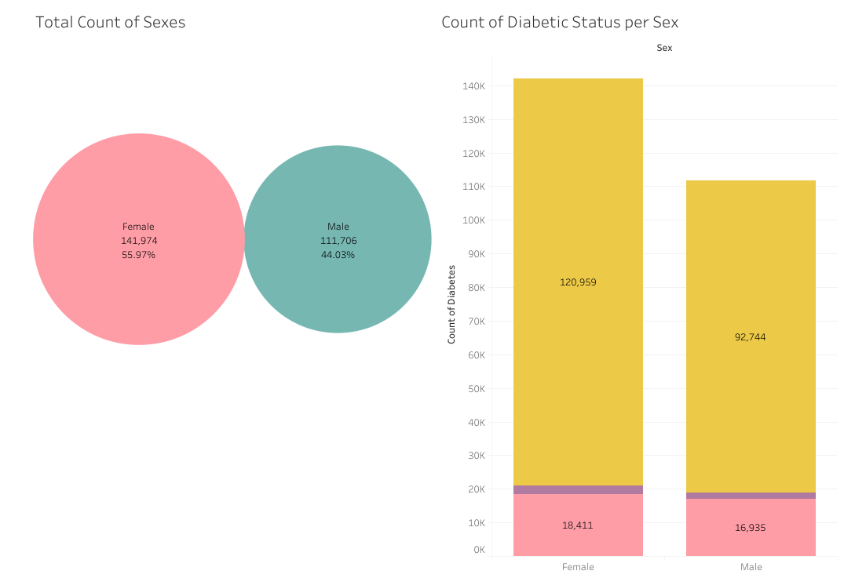
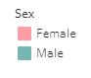
METHODS AND RESULTS

Slide 6
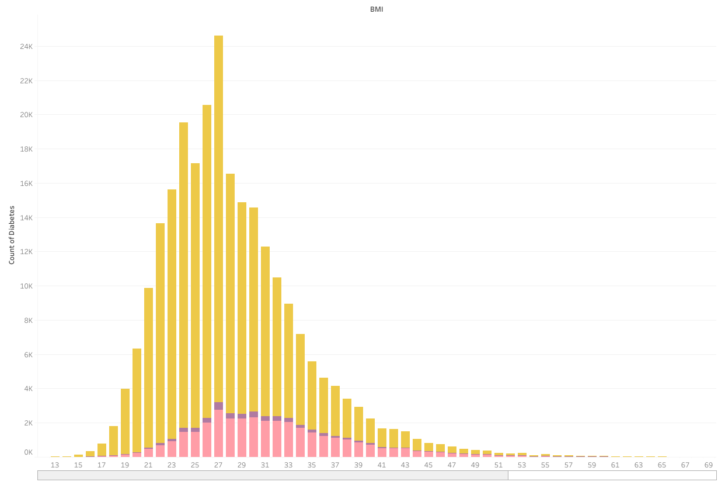
METHODS AND RESULTS

Slide 7
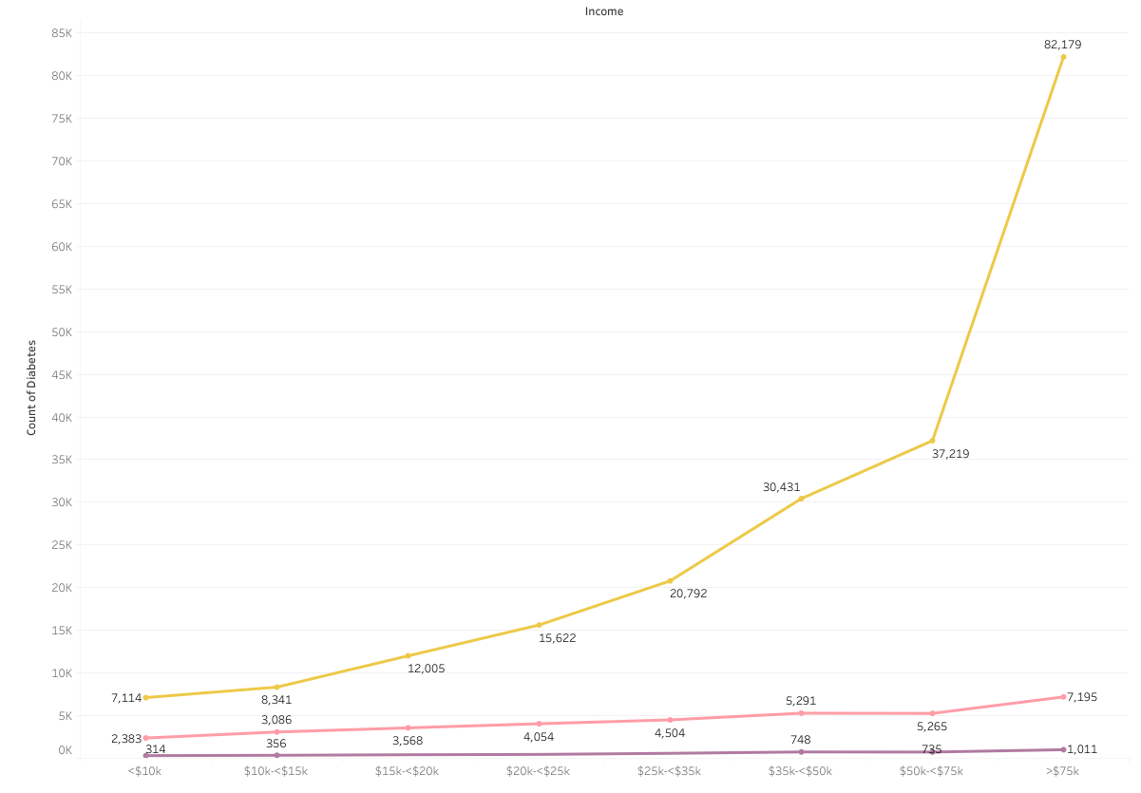
METHODS AND RESULTS

Slide 8
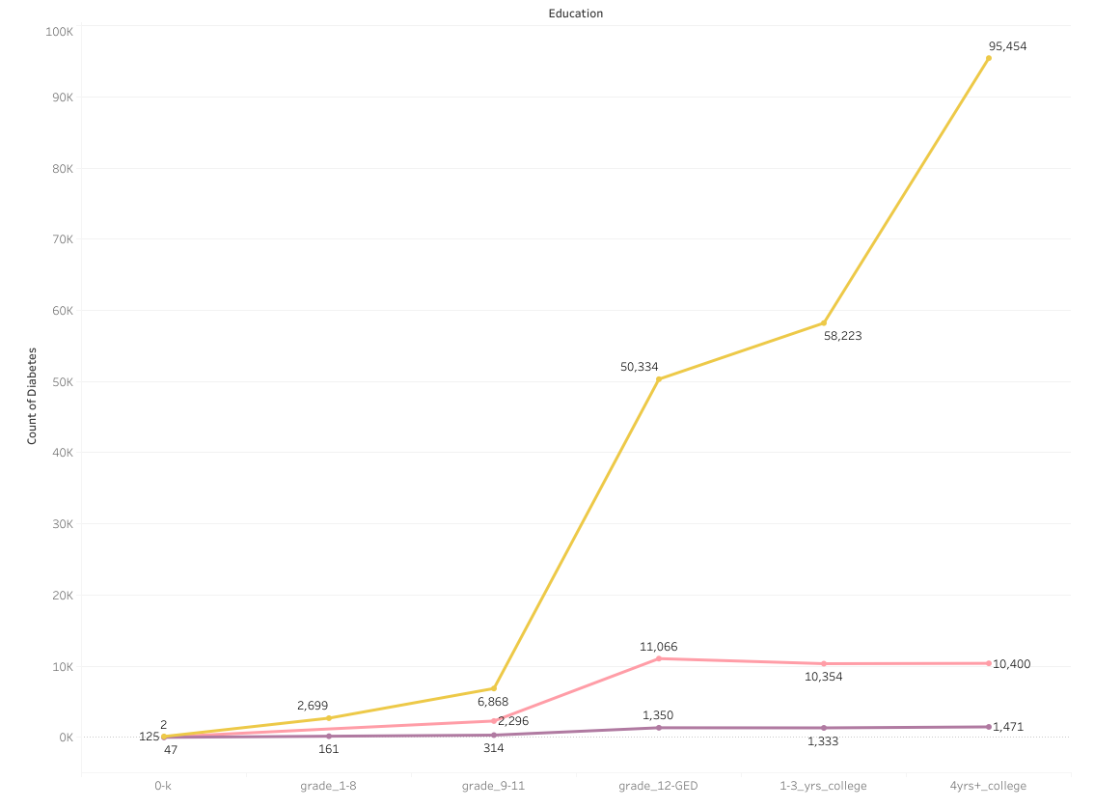
METHODS AND RESULTS

Slide 9
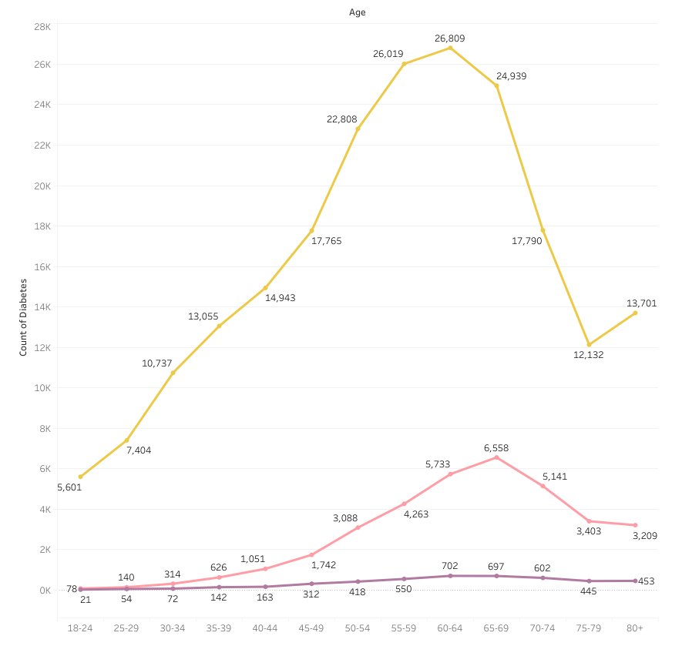
METHODS AND RESULTS

Slide 10
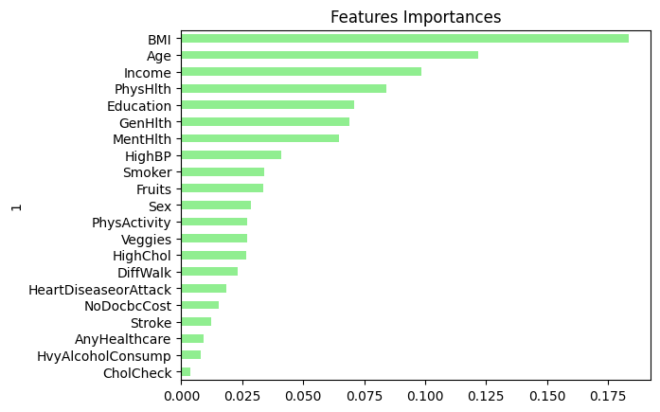
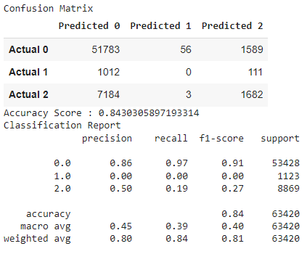
METHODS And results
The data frame was converted to Pandas from Spark
Random Forest Model
Pre-Diabetes was not predicted
Feature Importance obtained

Slide 11
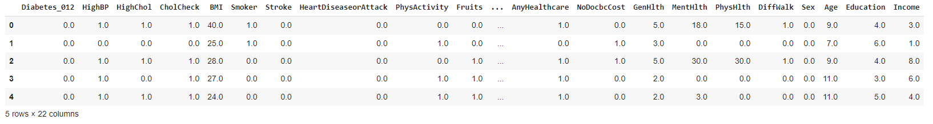
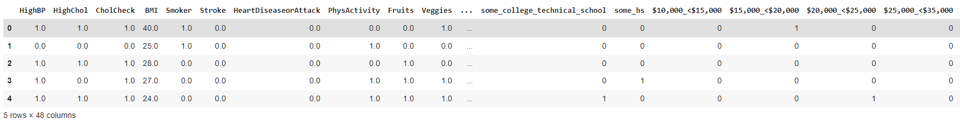
METHODS And results
Data Modeling
All categorical columns split with get_dummies
“Diabetes_012”, “Age”, “Education”, “Income”

Slide 12
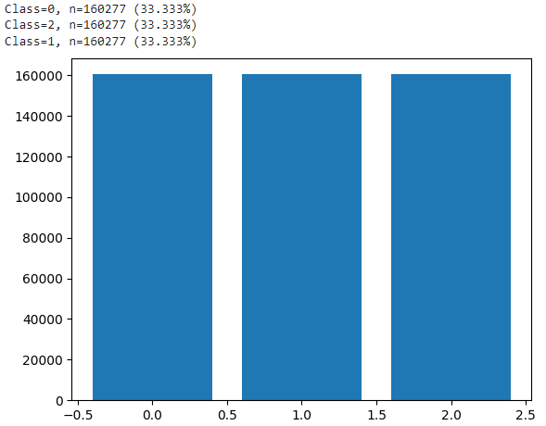
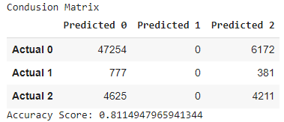
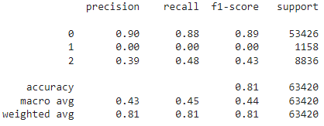
METHODS And results
Over Sampling
SMOTE
Logistic Regression
Notes:
utilized synthetic minority over-sampling technique (smote) to address class
imbalance in the pre-diabetes disease status population

Slide 13
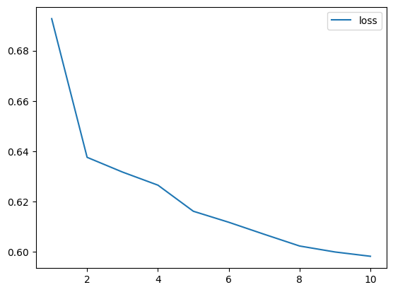
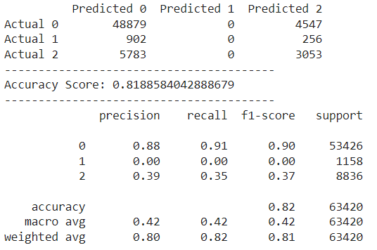
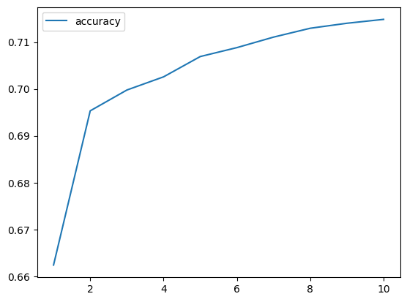
METHODS And results
Neural Network Model Using Oversampled Data
Oversampling did not predict prediabetes
Notes:
created a neural network model and added layers from a previously successful model (not in the notebook)

Slide 14
METHODS And results
Auto NN w/o prediabetes
Removed prediabetes from target and added to the features
Best hyperparameters and model
Notes:
created an automated neural network to test the best hyperparameter options

Slide 15
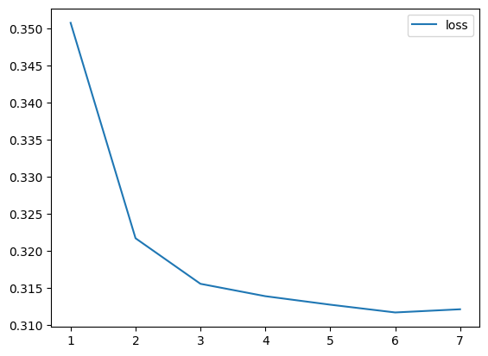
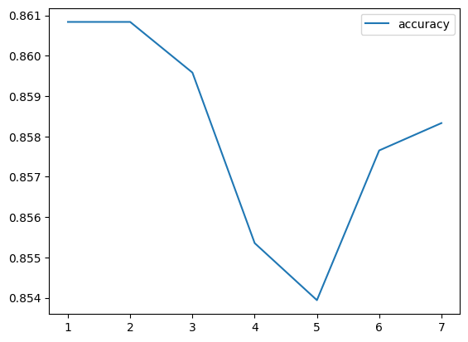
METHODS And results
NN Model using Best Hyperparameters
Notes:
created a model using the best hyperparameters from the auto NN
-
Did not perform how we'd like

Slide 16
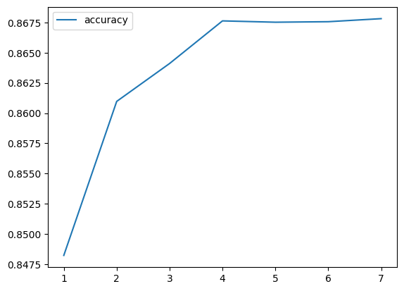
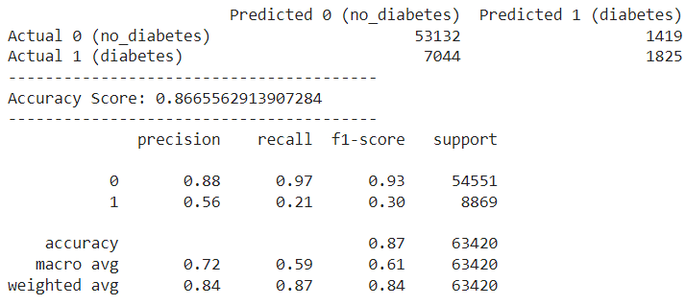
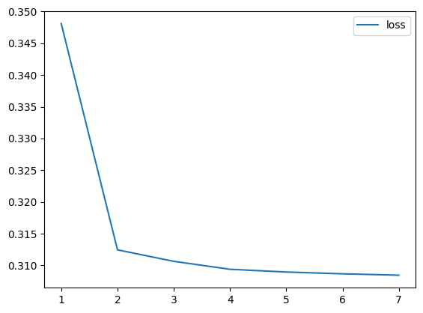
METHODS And results
NN Model using Best Model
Notes:
created a model using the best model from the auto NN
better accuracy and loss

Slide 17
Discussion, Limitations, Future Work
Challenges (Honorable Mentions)
Models Removed:
Original dataset:
Decision Tree
Logistic Regression
Neural Network with Random Oversampler
Processed dataset:
Logistic Regression with Random Oversampler
Logistic Regression with Multioutput Classifier and SMOTE Oversampler
Imbalanced Data
Feature Engineering

Slide 18


